Slide 1


Robotic Process Automation with Increasing Productivity using MachineLearning

Slide 2
TEAM MEMBERS
Rutik Govind Kulkarni
72028960C
Ayush Mishra
72028859C
Govind Sambhaji Bhujbal
72028911E
Prof. Rupali Shishupal
Guide
Sauraw Arun Diwase
72028890J

Slide 3
INDEX
1
Introduction
7
Algorithms
2
8
Problem Statement
UML Diagrams
3
9
Objectives
Result
4
10
Motivation
Future Scope
5
11
Literature Survey
Conclusion
6
Proposed System Architecture
12
References

Slide 4
INTRODUCTION
RPA is defined as an art of using software robots to interact with Software-as-a-Service applications and IT systems to automate the rule-based manual jobs associated with repetitive and transactional processes. The robot mimics the interactions of an employee with a system's user interface. The RPA services provide data security, enhanced business efficiency and effectiveness across various business applications without modifying available system and infrastructure. By using RPA we will get huge amount of data in DB from any website and by using ML algorithm we will increases its productivity.
RPA With ML

Slide 5
PROBLEM STATEMENT
In the light of growing competition and cost pressure, the digitalization of purchasing and supply management (PSM) constitutes a major investment priority for organizations as this area tends to lag behind other business functions . Fetch data using robotic process automation and using that data we can do the operations to predict the sales report which is then visualised using various techniques through Microsoft Power BI.

Slide 6
OBJECTIVE
Boost Productivity Across the Board
Improve Efficiency to Generate Savings
Hit Accuracy Goals with Reliable Consistency
Improve Business Data Security
Seize Opportunities for Scale
Produce Data for Important Analytics
Create a Better Customer Service Experience
Automate in Non-Disruptive Ways

Slide 7
MOTIVATION
How the combination of the two technologies would normally work is as follows. The role of RPA would be to structure and manage workflow for a process, extract needed information from multiple information systems, and perhaps make some simple decisions using rules. The RPA system would typically interact with a previously-created ML scoring application through the use of an API. The machine learning model, which would have been trained on data for which the outcomes are known, would use data that the RPA system pulled from transactional systems. Over time, the ML model could be retrained with new data.

Slide 8
LITERATURE SURVEY

Slide 9
Sr.NO | Title of the Paper | Year of publication | Method /algorithm used | Features/advantages/results | Limitation
1 | Robotic Process Automation Through Advance Process Analysis Model | 2020 | Integraed Defination Group of Modelling Method, Artificial Intelligence Method | Classify the process and provide suitability of the process for RPA | Factors like cost estimation, paybacks, and benefits
2 | Robotic Process Automation in purchasing and supply management: A multiple case study on potentials, barriers, and implementation | 2020 | RPA adoption in PSM | RPA has high connectivity to multiple software applications, thus complementing existing ERP | First, as with much qualitative research, our empirical study is restricted regarding the number and variety of examined organizations.

Slide 10
Sr. NO | Title of the Paper | Year of publication | Method /algorithm used | Features/advantages/results | Limitation
3 | Microsoft Power BI Desktop for Data Analytics | 2019 | Power BI (Visualisation Tools ) | Classify the result for visualization | MS-Power BI cannot be considered one single standalone software.
4 | Human Resource Analytics using Power Bi Visualization Tool | 2020 | Logistic Regression , Random Forest Classifier | Its implementation can boost up the economic growth of a company as it uses simple dashboards for performance levels. | Increase in complexity leads to lack in awareness.

Slide 11
Sr.NO | Title of the Paper | Year of publication | Method /algorithm used | Features/advantages/results | Limitation
5 | Predictive Analysis for Big Mart Sales Using Machine Learning Algorithms | 2020 | Holte’s Linear Trend Model, Holt winter Seasonal Method | The Method of forecasting for predicting sells value is very beneficial towards ERP system. | Unforeseen cash flow and unmanaged production, staff and financing.
6 | Business Forecasting System using Machine Learning Approach | 2021 | Deep Learning Network (DNN), Feed Forward Neural Network ( FFNN ) | ML technology is implemented to develop a prediction system and to forecast sale using the system. ML finds specific patterns or relationship from the training data . | Training error was found maximum for the commodity that has much price deviation over time.

Slide 12
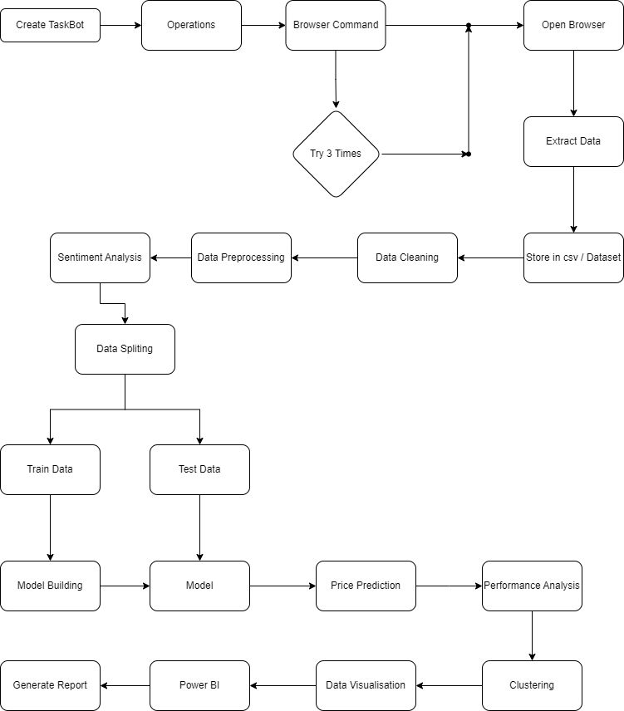
System Architecture

Slide 13
algorithm
Data Visualization Algorithm
Data visualization using various plots and charts. Here's the algorithm used in the code:
Import the required libraries for data visualization, namely matplotlib.pyplot and seaborn.
Scatter plot: Create a scatter plot using the scatter() function from matplotlib.pyplot. It plots the 'Selling Price' on the x-axis and 'Original Price' on the y-axis. Set the title, x-label, and y-label using the respective functions, and display the plot using plt.show().

Slide 14
Sentiment Analysis
Sentiment analysis on the 'Review' column of a DataFrame using the TextBlob library. Here's the algorithm used in the code:
Import the required library TextBlob for sentiment analysis.
Select the 'Review' column from the DataFrame df and store it in the variable 'reviews'.
Initialize an empty list sentiment_scores to store the sentiment scores.
Iterate through each review in the 'reviews' list.
Create a TextBlob object text_blob for each review.
Calculate the polarity of the review using the sentiment.polarity property of the TextBlob object. The polarity value ranges from -1 to 1, representing negative to positive sentiment.

Slide 15
Linear Regression for price prediction
Steps in Linear Regression: To implement the Linear Regression using Python, we will use the same steps as we have done in previous topics of Regression. Below are the steps:
Data Pre-processing step
Fitting Linear Regression to the Training set
Predicting the test result
Test accuracy of the result(Creation of Confusion matrix)
Visualizing the test set result.

Slide 16
Clustering
Prepare the data for clustering by selecting the columns specified in `columns_for_clustering` and assigning them to the variable `X`.
Prepare the data for clustering by selecting the data for the current column (`column_data`).
Impute missing values in the `column_data` using `SimpleImputer` with the strategy set to 'mean'.
Scale the data in the `column_data` using `StandardScaler`.
This algorithm performs K-means clustering on each column specified for clustering, adds the cluster labels as new columns to the dataset, and visualizes the clusters using scatter plots for each column.

Slide 17
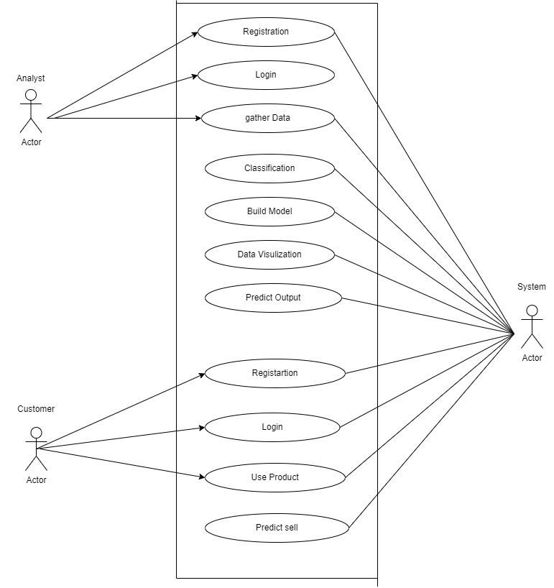
UML Diagrams ( Use case diagram )

Slide 18
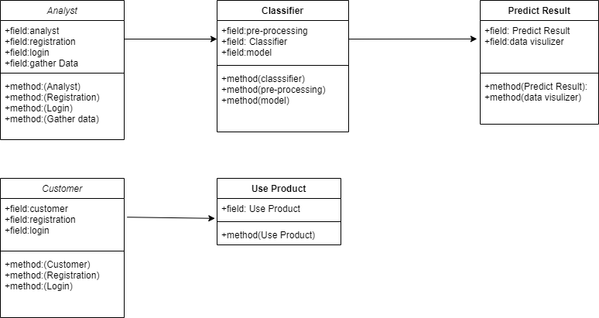
UML Diagrams
( Class diagram )

Slide 19
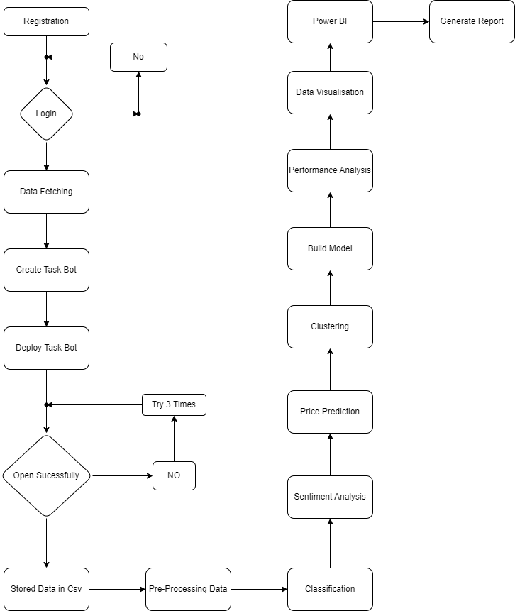
UML Diagrams ( Activity diagram )

Slide 20
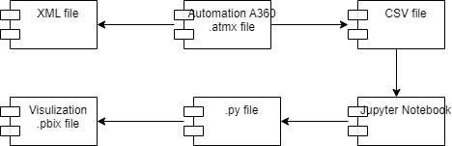
Component Diagram

Slide 21
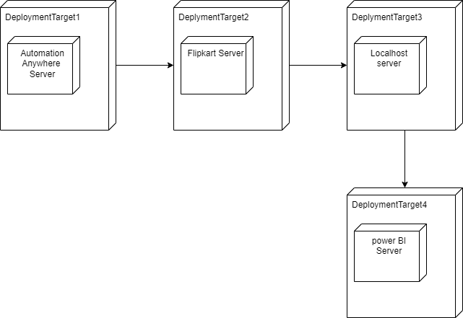
Deployment Diagram

Slide 22
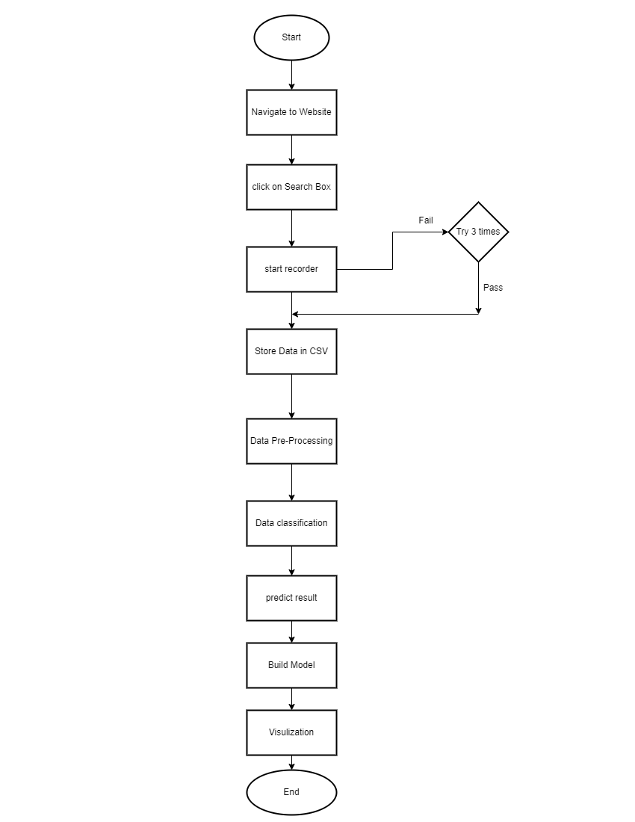
Flowchart

Slide 23
Future scope
Using RPA we can fetch the various Data from various websites and Data is useful for various business purposes
To analyse the sells data for Big Manufacturer
We can predict the sells using our model
To analyse the Business Intelligence
In many industries and business sectors we can use RPA & ML such as PSM, healthcare, education & many more.

Slide 24
Result
For Robotic Process Automation :
Exporting data to Flipkart_Data.csv : The RPA exports the collected data to a CSV file named Flipkart_Data.csv. The CSV file will have columns corresponding to the extracted data fields, with each row representing a product.
For Sentiment Analysis :
The given code performs sentiment analysis on the 'Review' column of a dataset using the TextBlob library. It calculates sentiment scores for each review and maps the sentiment to a numerical scale from 1 to 5. The outcome of running this code on the 'Flipkart_Data.csv' dataset would be the dataset 'df' with an additional column named 'Sentiment' that contains the sentiment scores for each review.

Slide 25
Result
For Price Prediction :
The given code performs price prediction using a Linear Regression model on the 'Flipkart_Data.csv' dataset. The outcome of running this code would be the printed mean squared error (MSE) value, which indicates the performance of the linear regression model in predicting the prices.
For Clustering :
Creates a K-means clustering model with 3 clusters.
For Recommendation : Recommends the best procuct to user.

Slide 26
CHALLENGES
1. Coordination issues
RPA implementation in an organization is a very special and crucial task, and it requires excellent coordination between all levels of the employees whomsoever involved in process automation.
2. Management Issues
When any major resolution is required to take place in any organization, consent from all levels must be obtained to execute it successfully.
3. RPA Customization
RPA sometimes requires customization based on the requirements of the organization.
4. Unclear expectations
Whenever we undergo a new process or a procedure, we must have a plan for it, and at the same time, we should have a clear idea of the outcomes that we are going to get.

Slide 27
5. Disconnected Dots
As we are aware that the RPA implementation is a crucial task and a lack of work responsibility of the employees would lead to underperformance.
6. Technical Ambiguity
One of the essential features of the RPA is its ease of installation. Even though it is easy to configure, the technical staff should always research the answers to satisfy technical and operational issues for the successful implementation of RPA. Maintenance of RPA is a crucial factor, and if you are not following regular protocol to maintain the RPA, it will lead to a lot of issues.
7. Infrastructure Issues
When implementing RPA, one of the biggest challenges that we face is infrastructural issues. Not only it is difficult to get everyone on board, but also it is complicated if your organization doesn't have an interconnected system that keeps on-premise or cloud infrastructure updated in real-time. A centralized infrastructure team plays a crucial role in expediting the RPA implementation process.
8. Picking the Wrong RPA
It is one of the commonly encountered issues by organizations while implementing the RPA. It's typically the implementation stage when the leaders realize that they have picked the wrong RPA tool for their business. They know that it's not fit for them when they unable to cope up with the customization needs and exceeds the investment they have expected.

Slide 28
Conclusion
We have successfully created a taskbot and deployed on flipkart server. We fetched data in the form of csv file format and then processed it using various machine learning (ML) algorithm such as text blob for sentiment analysis, Linear Regression for price prediction & k-Means for clustering. At the end we are also making a recommendation system which will recommend the best product as per requirement.

Slide 29
REFERENCES
Devansh Hiren Timbadia, Parin Jigishu Shah, Supriya Agrawal, Sughosh Sudhanvan (2020) Robotic Process Automation Through Advance Process Analysis Model
Christian Flechsig * , Franziska Anslinger, Rainer Lasch (2020)Robotic Process Automation in purchasing and supply management: A multiple case study on potentials, barriers, and implementation
João Garrott Marques Negreirosa, João Alexandre Lobo Marquesb (2019) Microsoft Power BI Desktop for Data Analytics
Mohammed Ameer, Simhadri Prem Rahul, Dr.Suneetha Manne (2020) Human Resource Analytics using Power Bi Visualization Tool
Ranjitha P1,Spandana M2 (2020) Predictive Analysis for Big Mart Sales Using Machine Learning Algorithms
Md. Anisur Rahman Mia*, Rupon Ghosh* (2021) Business Forecasting System using Machine Learning Approach
Shilpi Kulshrestha, M. L. Saini (2021) Study for the Prediction of E-Commerce Business Market Growth Using Machine Learning Algorithm

Slide 30
REFERENCES
Bruno Varela, Jorge Bernardino, Isabel Pedrosa (2020) Twitter Sensitivity Analysis in a Higher School Using Power BI
Wei Hu Haiyan Xie, Mantas Nakas, Wei Shi Mengmeng Wang,Xi’an China (2019) Power BI for Impacts Analysis on Cost of Living Caused by Industry Prevalence in Smart Cities
Estela Maria Macas Ruiz,Wayner Xavier Bustamante Granda,Diego Andrés Tinitana Orteg,Rommel Vicente Torres Tandazo (2019) Governance of Social Networks in the educational contextanalyzed through Power BI: Case Study Students belonging to the Pio Jaramillo Alvarado Institution.
Vijay Krishnan, S Bharanidharan, G Krishnamoorthy (2017) Research Data Analysis with Power BI
Ranjitha P1,Spandana M2 (2021) Predictive Analysis for Big Mart Sales Using Machine Learning Algorithms
Bernhard Axmann ,Harmoko Harmoko (2020) Robotic Process Automation: An Overview and Comparison to Other Technology in Industry 4.0
Vijay Krishnan, S Bharanidharan, G Krishnamoorthy (2017) Research Data Analysis with Power BI

Slide 31
Thank you

